Slide 1
Sorting Techniques
Visit: tshahab.blogspot.com
Notes:
Visit: tshahab.blogspot.com

Slide 2

Sorting
OUTPUT
a permutation of the
sequence of numbers
INPUT
sequence of numbers
Sort
a₁, a₂, a₃,….,a_{n}
b₁,b₂,b₃,….,b_{n}
2 5 4 10 7
2 4 5 7 10
Correctness
For any given input the algorithm halts with the output:
  b₁ < b₂ < b₃ < …. < b_{n}
  b₁, b₂, b₃, …., b_{n} is a permutation of a₁, a₂, a₃,….,a_{n}
Running time
Depends on
  number of elements (n)
  how (partially) sorted
  they are
  algorithm
Notes:
Visit: tshahab.blogspot.com

Slide 3
Introduction
Sorting is the process of ordering a list of objects, according to some linear order, such as ≤ for numbers.
Sorting can be divided into two types i.e. internal and external.
Internal sorting takes place in main memory of the computer, where we can make use of its random access nature.
External sorting is necessary when the number of objects to be sorted is too large to fit in the main memory.

Slide 4
Introduction
For external sorting, the bottleneck is usually the data movement between the secondary storage and the main memory.
Data movement is efficient if it is moved in the form of large blocks.
However, moving large blocks of data is efficient only if it is physically located in contiguous locations.

Slide 5
Internal sorting model
The simplest algorithms usually take O(n²) time to sort n objects, and suited for sorting short lists.
One of the most popular algorithms is Quick-Sort takes O(nlogn) time on average.
Quick-Sort works for most common applications, although in worst case it can take time O(n²) .

Slide 6
Internal sorting model
There are other sorting techniques, such as Merge-Sort and Heap-Sort that take time O(nlogn) in worst case.
Merge-Sort however, is well suited for external sorting.
There are other algorithms such as “bucket” and “radix” sort when the keys are integers of known range. They take time O(n).

Slide 7
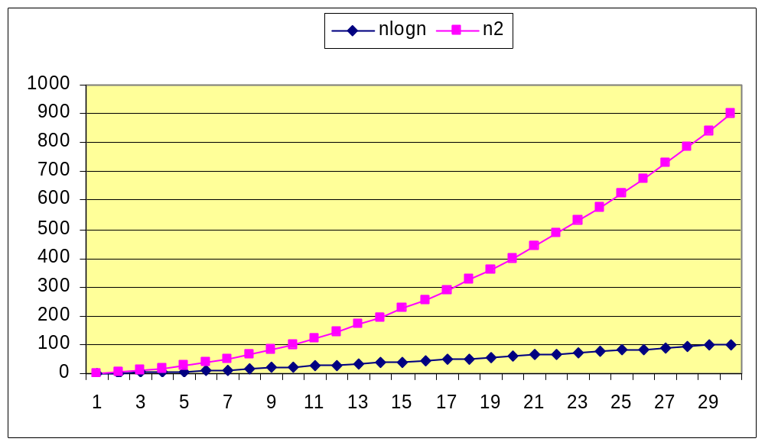
Quadratic Vs Logarithmic
Notes:
Visit: tshahab.blogspot.com

Slide 8
Evaluation Criteria
There are many criterion to evaluate the running time, as follows:
  Number of algorithm steps.
  Number of comparisons between the keys.
  The number of times a record is moved (for large records).
Notes:
Visit: tshahab.blogspot.com

Slide 9
Internal sorting model
Insertion Sort
On the i^{th} pass we “insert” the ith element A[i] into its rightful place among A[1],A[2],…A[i-1] which were placed in sorted order.
After this insertion A[1],A[2],…A[i] are in sorted order.

Slide 10
Insertion Sort
A
3
4
6
8
9
7
2
5
1
1
j
n
i
Strategy
Start “empty handed”
Insert a card in the right
position of the already sorted
hand
Continue until all cards are
inserted/sorted
for j=2 to length(A)
do temp=A[j]
“insert A[j] into the
sorted sequence A[1..j-1]”
i=j-1
while i>0 and A[i]>temp
do A[i+1]=A[i]
i--
A[i+1]:=temp
Notes:
Visit: tshahab.blogspot.com

Slide 11
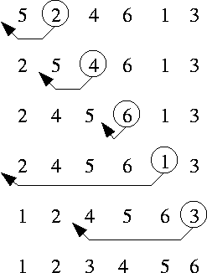
Insertion Sort

Slide 12
Insertion Sort
Time taken by Insertion Sort depends on input: 1000 takes longer than 3 numbers
Can take different amounts of time to sort 2 input sequences of the same size
In general, the time taken by an algorithm grows with the size of the input
Describe the running time of a program as function of the size of input

Slide 13
Analysis of Algorithms
Efficiency:
  Running time
  Space used
Efficiency as a function of input size:
  Number of data elements (numbers, points)
  A number of bits in an input number

Slide 14


Analysis of Insertion Sort
Time to compute the running time as a function of the input size
1.for j=2 to length(A)
2. do key=A[j]
3.“insert A[j] into the
sorted sequence A[1..j-1]”
4. i=j-1
5. while i>0 and A[i]>key
6. do A[i+1]=A[i]
7. i--
8. A[i+1]:=key
cost
c₁
c₂
c₃
c₄
c₅
c₆
c₇
c₈
times
n
n-1
n-1
n-1
n-1
Notes:
Visit: tshahab.blogspot.com

Slide 15
Insertion-Sort Running Time
T(n) = c₁ • [n] + c₂ • (n-1) + c₃ • (n-1) + c₄ •
(n-1) + c₅ • (Σ_{j=2,n} t_{j}) +
c₆ • ( Σ_{j=2,n} (t_{j} -1) ) + c₇ • ( Σ_{j=2,n} (t_{j} -1) )
+ c₈ • (n-1)
c₃ = 0, of course, since it’s the comment

Slide 16
Best/Worst/Average Case
Best case: elements already sorted ® t_{j}=1, running time = f(n), i.e., linear time.
Worst case: elements are sorted in inverse order ® t_{j}=j, running time = f(n²), i.e., quadratic time
Average case: t_{j}=j/2, running time = f(n²), i.e., quadratic time

Slide 17
Best Case Result
Occurs when array is already sorted.
For each j = 2, 3,…..n we find that A[i]<=key in line 5 when we have its initial value of j-1.
T(n) =
c₁ • n + (c₂ + c₄) • (n-1) + c₅ • (n-1)+ c₈ • (n-1)
= n • ( c₁ + c₂ + c₄ + c₅ + c₈ )
+ ( -c₂ – c₄ - c₅ – c₈ )
= c₉n + c₁₀
= f₁(n¹) + f₂(n⁰)

Slide 18
Worst Case T(n)
Occurs when the loop of lines 5-7 is executed as many times as possible, which is when A[] is in reverse sorted order.
key is A[j] from line 2
i starts at j-1 from line 4
i goes down to 0 due to line 7
So, t_{j} in lines 5-7 is [(j-1) – 0] + 1 = j
The ‘1’ at the end is due to the test that fails, causing exit from the loop.

Slide 19
Cont’d
T(n) = c₁ • [n]+ c₂ • (n-1) + c₄ • (n-1)
+ c₅ • (Σ_{j=2,n} j)+ c₆ • [ Σ_{j=2,n} (j -
1) ] + c₇ • [ Σ_{j=2,n} (j -1) ]+ c₈ •
(n-1)

Slide 20
Cont’d
T(n) =
c₁ • n + c₂ • (n-1) + c₄ • (n-1) + c₈ • (n-1)
+ c₅ • (Σ_{j=2,n} j)
+ c₆ • [ Σ_{j=2,n} (j -1) ]+ c₇ • [ Σ_{j=2,n} (j -1) ]
= c₉ • n + c₁₀ + c₅ • (Σ_{j=2,n} j) + c₁₁ •
[Σ_{j=2,n} (j -1) ]

Slide 21
Cont’d
T(n) = c₉ • n + c₁₀ + c₅ • (Σ_{j=2,n} j) + c₁₁ • [ Σ_{j=2,n} (j -1) ]
But
Σ_{j=2,n} j = [n(n+1)/2] – 1
so that
Σ_{j=2,n} (j-1) = Σ_{j=2,n} j – Σ_{j=2,n} (1)
= [n(n+1)/2] – 1 – (n-2+1)
= [n(n+1)/2] – 1 – n + 1 = n(n+1)/2 - n
= [n(n+1)-2n]/2 = [n(n+1-2)]/2 = n(n-1)/2

Slide 22
Cont’d
In conclusion,
T(n) =
c₉ • n + c₁₀ + c₅ • [n(n+1)/2] – 1 + c₁₁ • n(n-1)/2
= c₁₂ • n² + c₁₃ • n + c₁₄
= f₁(n²) + f₂(n¹) + f₃(n⁰)

Slide 23
Extended Example
To sort the following numbers in increasing order:
34 8 64 51 32 21
j = 1; Look at first element only, no change.
j = 2; tmp = 8;
34 > tmp, so second element is set to 34.
We have reached the front of the list. Thus, 1st position = tmp
After second pass: 8 34 64 51 32 21
(first 2 elements are sorted)
Notes:
Visit: tshahab.blogspot.com

Slide 24
j = 3; tmp = 64;
34 < 64, so stop at 3rd position and set 3rd position = 64
After third pass: 8 34 64 51 32 21
(first 3 elements are sorted)
j = 4; tmp = 51;
51 < 64, so we have 8 34 64 64 32 21,
34 < 51, so stop at 2nd position, set 3rd position = tmp,
After fourth pass: 8 34 51 64 32 21
(first 4 elements are sorted)

Slide 25
j = 5; tmp = 32,
32 < 64, so 8 34 51 64 64 21,
32 < 51, so 8 34 51 51 64 21,
next 32 < 34, so 8 34 34 51 64 21,
next 32 > 8, so stop at 1st position and set 2nd position = 32,
After fifth pass: 8 32 34 51 64 21
j = 6; tmp = 21, . . .
After sixth pass: 8 21 32 34 51 64

Slide 26
Analysis: worst-case running time
Inner loop is executed j times, for each j=1..N
⇒ Overall: O(N²)
Space requirement is O(N)
for j=2 to length(A)
do temp=A[j]
“insert A[j] into the
sorted sequence A[1..j-1]”
i=j-1
while i>0 and A[i]>temp
do A[i+1]=A[i]
i--
A[i+1]:=temp

Slide 27
Bubble Sort
Also known as exchange sort
It works repeatedly stepping through the list to be sorted, comparing two items at a time and swapping them if they are in wrong order

Slide 28
Algorithm
1. Repeat Steps 2 and 3 for k=1 to N-1
Set p = 1
repeat while p<= N-k
  if A[p] > A[p+1] then swap A[p] and A[p+1]
  p= p+1
  [end of inner loop]
  [end of outer loop]
  4. Exit

Slide 29
Example
Element | 1 | 2 | 3 | 4 | 5 | 6 | 7 | 8
Data | 27 | 63 | 1 | 72 | 64 | 58 | 14 | 9
1st pass | 27 | 1 | 63 | 64 | 58 | 14 | 9 | 72
2nd pass | 1 | 27 | 63 | 58 | 14 | 9 | 64 | 72
3rd pass | 1 | 27 | 58 | 14 | 9 | 63 | 64 | 72...

Slide 30
Selection Sort
Given an array of length n,
  Search elements 0 through n-1 and select the smallest
    Swap it with the element in location 0
  Search elements 1 through n-1 and select the smallest
    Swap it with the element in location 1
  Search elements 2 through n-1 and select the smallest
    Swap it with the element in location 2
  Search elements 3 through n-1 and select the smallest
    Swap it with the element in location 3
  Continue in this fashion until there’s nothing left to search

Slide 31
Example and analysis of Selection Sort
The Selection Sort might swap an array element with itself--this is harmless.
7
2
8
5
4
2
7
8
5
4
2
4
8
5
7
2
4
5
8
7
2
4
5
7
8
Notes:
Visit: tshahab.blogspot.com

Slide 32
Code for Selection Sort
void selectionSort(int a[], int size)
{
int outer, inner, min;
for (outer = 0; outer < size; outer++)
{ // outer counts down
min = outer;
for (inner = outer + 1; inner < size; inner++)
{
if (a[inner] < a[min])
{
min = inner;
}
}
// a[min] is least among a[outer]..a[a.length - 1]
int temp = a[outer];
a[outer] = a[min];
a[min] = temp;
}
}

Slide 33
Quick Sort
Quick Sort : Based on Divide and Conquer paradigm.
One of the fastest in-memory sorting algorithms
  designed by C.A.R.Hoare in 1960.
Consists of two phases:
  Partition phase
  Sort phase

Slide 34
Steps...
1. Divide: Pick a pivot element and rearrange the array so that
- all elements to the left of the pivot are
smaller than the pivot.
- all elements to the right of the pivot are larger
than the pivot.
2. Conquer: Recursively quicksort the left and right subarrays.
3:Combine: since subarrays are sorted in place, no work is needed to combine them,array is now sorted.

Slide 35
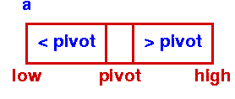
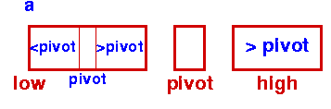
Quicksort
Initial Step - First Partition
Sort Left Partition in the same way
Notes:
Visit: tshahab.blogspot.com

Slide 36
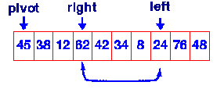
Quicksort – Partition phase
Goals:
  Select pivot value
  Move everything less than pivot value to the left of it
  Move everything greater than pivot value to the right of it

Slide 37
Algorithm: Quick Sort
Procedure QuickSort ( A, l, r )
if ( r > l ) then
j ← partition ( A, l, r );
QuickSort ( A, l, j - 1 );
QuickSort ( A, j + 1 , r );
end of if.

Slide 38
l
r
A
9 8 2 3 88 34 5 10 11 0
Partition
A
5 8 2 3 0 9 34 11 10 88
l
j
r

Slide 39
Algorithm: Partition
Function Partition (A, l, r )
v ← a[ l ]; i ← l ; j ← r;
while i<j
while (A[i]<=v && i<r) i++;
while (A[j]>v ) j--;
if (i<j) then swap (a[ i ], a[ j ]);
A [ l ] = a[ j ]; a[ j ] ← v;
return ( j );
There are various algorithms for partition.
Above Algorithm is the most popular. This is because it does
not need an extra array. Only 3 variables v,i, and j.

Slide 40
i
v
9
j
v = a[ l ]; i = l ; j = r;
while i<j
while (A[i]<=v && i<r) i++;
while (A[j]>v ) j--;
if (i<j) then swap (a[ i ], a[ j ]);
A [ l ] = a[ j ]; a[ j ] = v;
return ( j );
9 8 2 3 88 34 5 10 11 0
i
j
9 8 2 3 88 34 5 10 11 0
i
j
9 8 2 3 0 34 5 10 11 88
i
j
9 8 2 3 0 34 5 10 11 88
Notes:
Visit: tshahab.blogspot.com

Slide 41
i
j
v = a[ l ]; i = l ; j = r;
while i<j
while (A[i]<=v && i<r) i++;
while (A[j]>v ) j--;
if (i<j) then swap (a[ i ], a[ j ]);
A [ l ] = a[ j ]; a[ j ] = v;
return ( j );
9 8 2 3 0 5 34 10 11 88
j
i
out of outer
while loop
9 8 2 3 0 5 34 10 11 88
j
i
5 8 2 3 0 9 34 10 11 88

Slide 42
Procedure QuickSort ( A, l, r )
if ( r > l ) then
j ← partition ( A, l, r );
QuickSort ( A, l, j - 1 );
QuickSort ( A, j + 1 , r );
end of if.
j
i
5 8 2 3 0 9 34 10 11 88
5 8 2 3 0
34 10 11 88

Slide 43
i
v
5
j
v = a[ l ]; i = l ; j = r;
while i<j
while (A[i]<=v && i<r) i++;
while (A[j]>v ) j--;
if (i<j) then swap (a[ i ], a[ j ]);
A [ l ] = a[ j ]; a[ j ] = v;
return ( j );
5 8 2 3 0
i
j
5 8 2 3 0
i
j
swap
5 0 2 3 8
j
i
5 0 2 3 8

Slide 44
v = a[ l ]; i = l ; j = r;
while i<j
while (A[i]<=v && i<r) i++;
while (A[j]>v ) j--;
if (i<j) then swap (a[ i ], a[ j ]);
A [ l ] = a[ j ]; a[ j ] = v;
return ( j );
j
i
3 0 2 5 8

Slide 45
Time Complexity
So time complexity is O(nlogn)
  O(n) work is required to partition at each of log n levels of recursion
  Number of comparisons performed for all partitions
    n + 2(n/2) + 4 (n/4) + 8(n/8) + … + n(n/n) = n( logn +1)
    Which is O(nlogn)
In cases, in which data are very nearly in the correct order, the partitions will be very unequal in size
  It will cause the number of levels of recursion to approach N rather log N, resulting in O(N²)

Slide 46
The worst case is when the input is already sorted.
1 2 3 4 5 6 7 8
1 2 3 4 5 6 7 8
1 2 3 4 5 6 7 8
1 2 3 4 5 6 7 8
1 2 3 4 5 6 7 8
1 2 3 4 5 6 7 8
1 2 3 4 5 6 7 8
1 2 3 4 5 6 7 8

Slide 47
Randomized Quick Sort
Randomize the input data before giving it to Quick Sort. OR
In the partition phase, rather than choosing first value to be the pivot value, choose a RANDOM value to be pivot value.
This makes Quick Sort run time independent of input ordering
So Worst case won’t happen for SORTED inputs but may only happen by worseness of random number generator.
Notes:
Visit: tshahab.blogspot.com

